Slide 1
Flashlight app
Andy Haryanto - 2001538824
Patrick Leonardus - 2001536245

Slide 2

Project apps
The simple project that we created is a flashlight application
There are two reasons why we created this app :
Flashlight is a simple and easy application that can be created by us
Flashlight is a utility that is quite widely used
There are so many tutorial to make this app

Slide 3
Apps feature
LED Flashlight
Brightness adjustment
Custom flash mode (Police Rotator mode, SOS mode & another mode)
Auto ON/OFF flash
Screen Flashlight
Custom color flashlight
Brightness adjustment
Custom flash mode
Auto ON/OFF flash

Slide 4



Apps design
Application design based on android app design
When we want to turned the flashlight on, just tap “ON” button :
Otherwise, to turn off the flashlight, just tap “OFF” button :
Icon App :
Yellow color represents brightness
the ash depicts the darkness

Slide 5
OOP Concept
Object Oriented that we used in our apps
Override :
This allow us to build the specific implementation of method that is provided by one of it method
Encapsulation :
This concept is used to manipulate the data & make the data safe from outside interference
Inheritance
To extend contain from class to another class

Slide 6
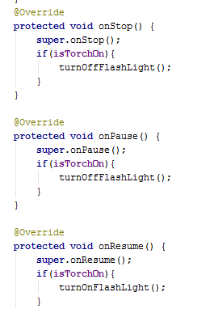
Override
This override method is used to build a stop & start command

Slide 7
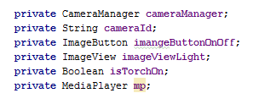
encapsulation
This method is created to be accessible only by the intended class

Slide 8
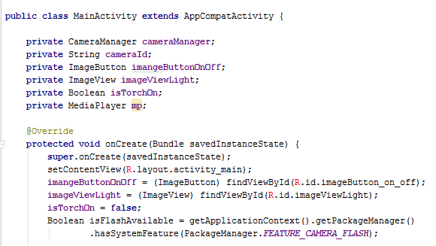
inheritance
This method is used to extend Main Activity class from AppCombatActivity class

